Slide 1
Mobile App Framework Discussion
Kevin

Slide 2

Location-transparency
Do we always want location-transparent?
Opposite: Users want to be aware of offline/online and action results explicitly

Slide 3
Location-transparent Model
Program A
Client/
Server
Currently achieved by having program running pure-server side
“Please wait”
Client
Server
Program A

Slide 4
VLDB 2010 effort
Reduce/eliminate “please wait”
User changing page state overlaps with program (server-side) changing page state
But no client action/program
“Please wait”
Client
Server
Program A
Program B

Slide 5
Go distributed!
Program A-c
Client
Server
Program A-s
A-c U A-s = A
If you were the developer, how would you determine/find the split?

Slide 6
Split considerations
Some computation is business secret. It should be server-side (A-s) only
Possible to run “encrypted” computation?
Some data is secret and cannot be sent to client.
Hence computation has to be A-s too.
Some data schema is secret too
Non-secret
computation
Program A-c
Client
Server
Program A-s

Slide 7
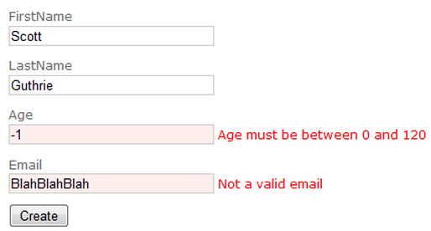
Split considerations (cont’d)
Is it really a split?? i.e., A-c ∩ A-s = {} ??
Client-side validation checking (for fast response and better user experience)
Server-side validation checking still needed
There is overlap!
Program A-c
x
Client
x
Server
Program A-s

Slide 8

“Split” considerations (cont’d)
Push it further: A-c may diverge from original location-transparent specification
More things happen at server-side, some of them are secrets
A-c takes shortcut and displays (most likely) result first
A-s does the real work (and hopefully the results agree)

Slide 9
Recap: How would you build such an app?
You cache only “safe” data, or view on client
You write A-c mainly because you want
Fast response
Offline availability
But you do NOT (always) let A-c change the server data because
Server-side full-version/secret computation
Even if computation is not secret, you do not want to do it on client-side only
(Of course if some data is totally local you can let A-c manipulate it)

Slide 10
How does it fit in rendered-view approach?

